Slide 1
The Standard for the IoT

Slide 2
Our vision: We believe all objects can work together in a way that enhances the way we live, work, and play
Our mission: The Zigbee Alliance ignites creativity and collaboration in the Internet of Things, by creating, evolving, and promoting universal open standards that enable all objects to connect and interact.

Slide 3
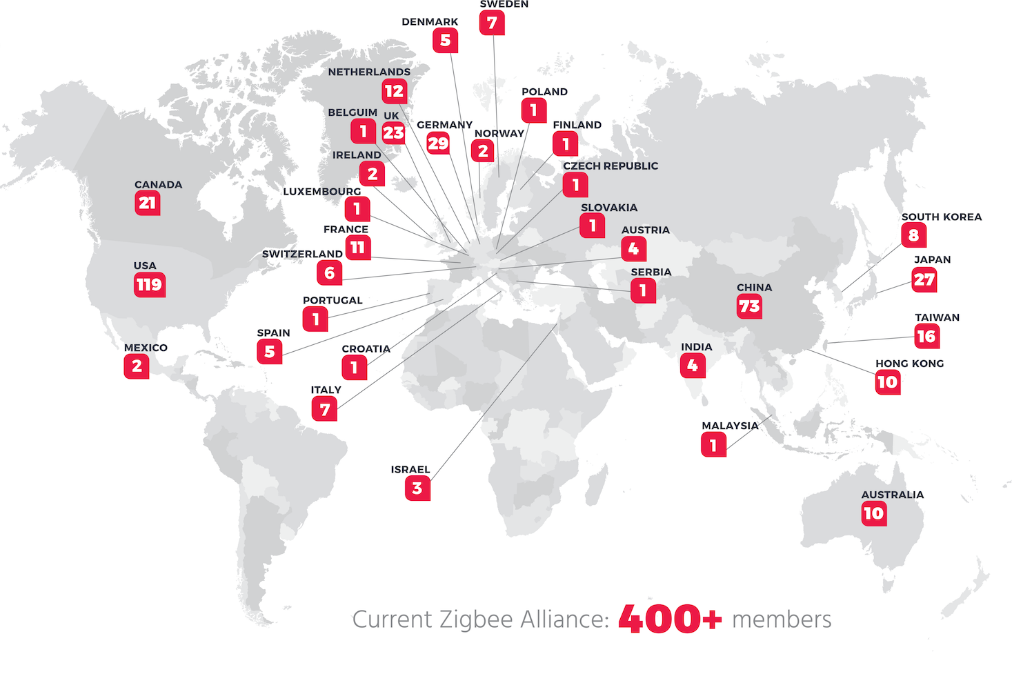
We are the standard bearer of the open IoT
Established in 2002, our wide-ranging global membership collaborates to create and evolve universal open standards for the smart networks in our homes, businesses, and neighborhoods.
Our standards are the only complete IoT solution – from mesh network to the universal language that allows smart objects to work together.

Slide 4
Our Board of Directors

Slide 5
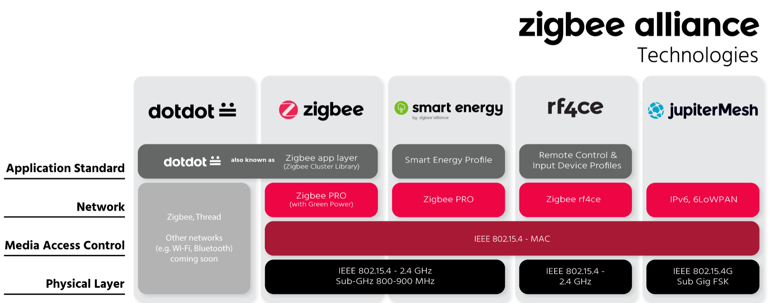
What we do
Develop open, global standards for wireless connectivity and device-to-device communication, enabling IoT devices.
Certify products built to our standards to ensure interoperability between them.

Slide 6
Major initiative: Zigbee
20+ Compliant Platforms (silicon)
Half a billion chipsets sold worldwide
Over 2,500 Certified Products on the market.
© 2017 zigbee alliance. All rights reserved.
Notes:
<編號>

Slide 7
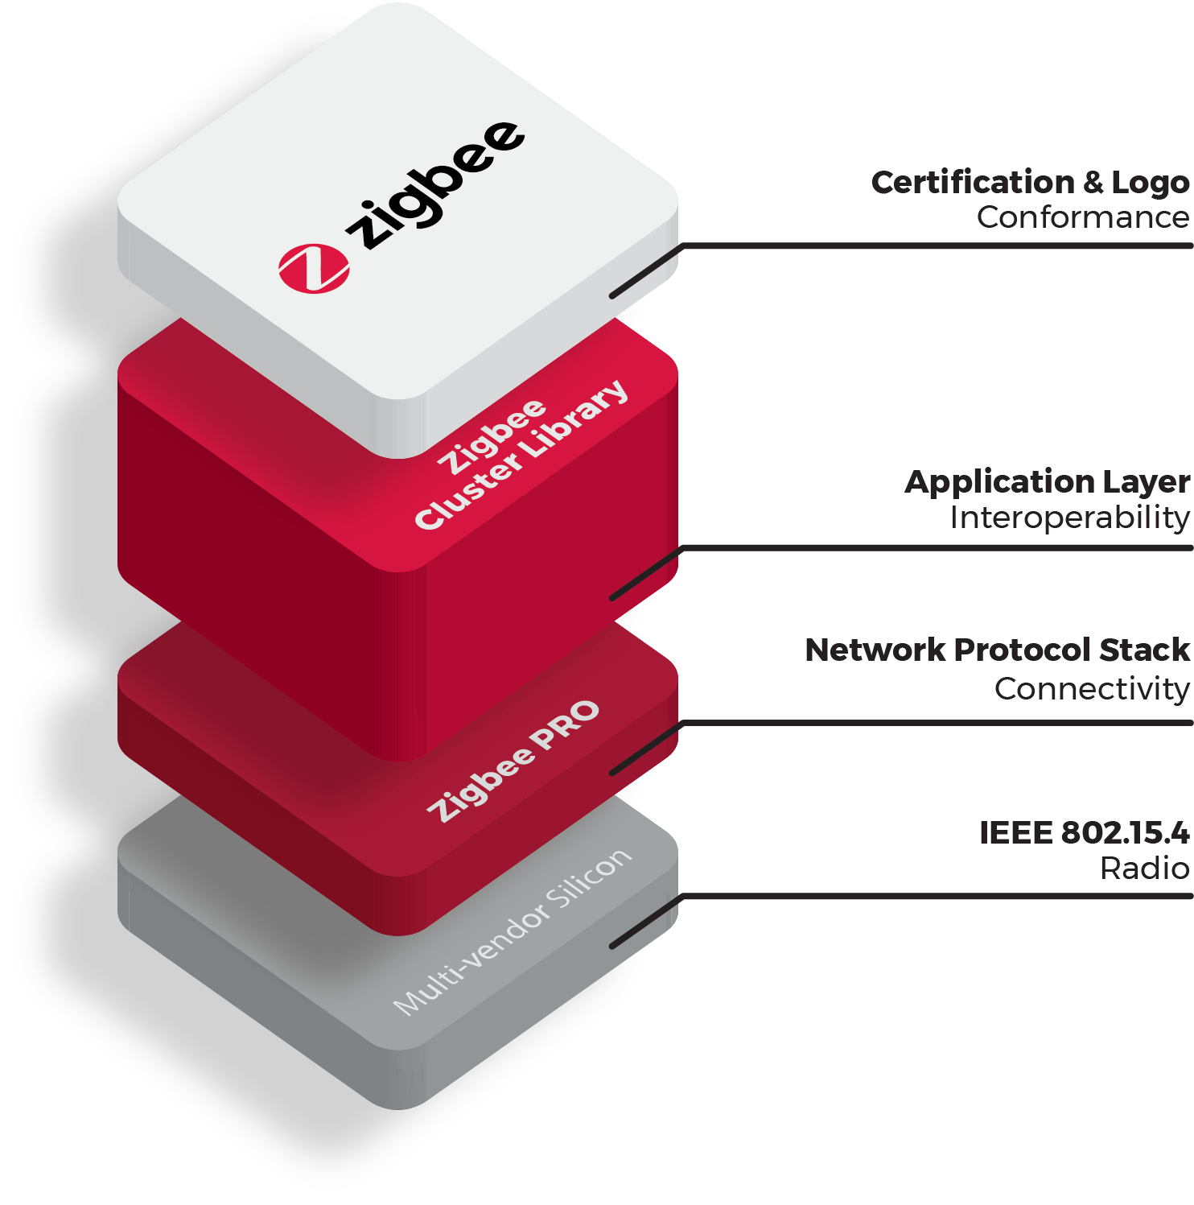
Zigbee is the only complete loT solution — from mesh network to the universal language that allows smart objects to work together.
Zigbee increases choice and flexibility for users and developers, and delivers the confidence that products and services will work together through standardization and testing of all layers of the stack.

Slide 8
Zigbee leading the industry
Zigbee Certifications growing exponentially
Includes lighting, sensors, reference designs, with more in the pipeline.
75+ device types and growing
Zigbee products are backwards-compatible with existing Zigbee products built to previous specifications
They can connect and communicate using the same IoT language with each other, and millions of Zigbee products already deployed in smart homes and buildings.
Notes:
<編號>

Slide 9
How Zigbee works
© zigbee alliance. All rights reserved. CONFIDENTIAL

Slide 10
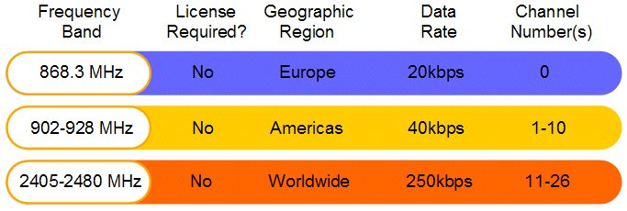
IEEE 802.15.4
IEEE 802.15.4 2003
8

Slide 11
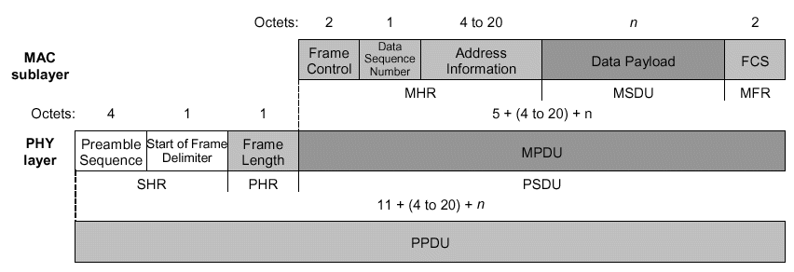
IEEE 802.15.4 Data Frame Format
Provides up to 102 Byte data payload capacity
Data sequence numbering to ensure that packets are tracked
Frame Check Sequence (FCS) validates error-free data
min. 16 Bytes = 128 bits = 0.512 ms @ 250 kbps
max. 133 Bytes = 1064 bits = 4.256 ms @ 250 kbps
11

Slide 12
IEEE 802.15.4 Device Types
802.15.4 Device Types Full function device (FFD) Talks to several devices Normally main powered (always on) Can route messages Reduced Function Device (RFD) Carries limited functionality to control cost and complexity Talks to parent | Requires less memory Can be a sleeping device General usage will be in network edge devices
11
Notes:
802.15.4 supports 2 main device types in the network. Full funtion deivces and reduced function device types.
Full function devices can talk to several devices on the network and are typically always on, thus they do not sleep. They can funtion as the coordinator, routers and even end devices. Coordinators are responsible for starting and managing the network, where routers simply join networks and route messages along the path to the destination. Coordinators and routers can have multiple children, including other routers. FFD devices typically require slightly more memory to handle routing tables, buffering of messages, etc.
Reduce function devices or end devices are limited function devices to help control cost and complexity by requiring less memory then a FFD. They are typically a specific fuction device such as a sensor, etc for collecting and sending data and are at the edge of the network. It is also common for end devices to be battery powered, thus a sleeping device. This means it only wakes up on a perodic time to send data or check with it’s parent to see if there is a message waiting for it.

Slide 13
Network Topology Models
Three Common 802.15.4 Networks
Star Network
Lowest complexity
Limited Range
Coordinator can become bottleneck
PAN coordinator (PANC)
Full Function Device (FFD,Router)
Reduced Function Device (RFD)
11

Slide 14
Network Topology Models
Three Common 802.15.4 Networks
Tree Network
Extends range of network
More predictive
Bottlenecks still exist
PAN coordinator (PANC)
Full Function Device (FFD,Router)
Reduced Function Device (RFD)
11

Slide 15
Network Topology Models
Three Common 802.15.4 Networks
Mesh Network
Most complex
Highest reliability
Reduces bottlenecks
PAN coordinator (PANC)
Full Function Device (FFD,Router)
Reduced Function Device (RFD)
15

Slide 16

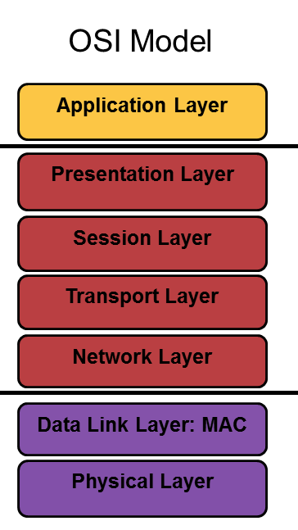
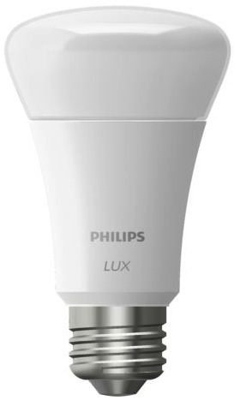
Standardized at all Layers
Zigbee PRO
16
Notes:
<編號>

Slide 17
Zigbee – PAN Coordinator
PAN Coordinator
“Owns” the network
Starts it
Opens the network for joining
Allocates address
Saves messages until they can be delivered (to its children)
Can function as Trust Center
A “full-function device” – FFD
Mains-powered
Can have other functionality
Sensor
Monitor
17

Slide 18
Zigbee - Router
Routers
Routes messages
Does not own or start network
Scans to find a network to join
Given a block of addresses to assign
A “full-function device” – FFD
Mains-powered
Can have other functionality
Sensor
Monitor
18

Slide 19
Zigbee – End Device
End Device
Specific Device function
Sensor
Monitor
Communicates with a single device (parent)
Does not own or start network
Scans to find a network to join
Can be an FFD or RFD
Does NOT route packets
Often battery-powered
18

Slide 20
Zigbee PRO Network Communication Model – Centralized Security
Mesh, self-organizing, self-healing topology scalable to thousands of nodes
Interference tolerance via clear channel assessments, retries, etc.
Point to Point communication gives range > 100 m, and full mesh deployment can have several kilometer range
Zigbee Coordinator (FFD)
Zigbee Router (FFD)
Zigbee End Device (RFD or FFD)
Bi-directional Mesh Link
20
Notes:
FFD: Full functioning device
RFD: Reduced functioning device (eg, battery powered)
<編號>

Slide 21
Zigbee PRO Network Communication Model – Distributed Security
Mesh, self-organizing, self-healing topology scalable to thousands of nodes
Interference tolerance via clear channel assessments, retries, etc.
Point to Point communication gives range > 100 m, and full mesh deployment can have several kilometer range
Zigbee Coordinator (FFD)
Zigbee Router (FFD)
Zigbee End Device (RFD or FFD)
Bi-directional Mesh Link
21
Notes:
FFD: Full functioning device
RFD: Reduced functioning device (eg, battery powered)
<編號>

Slide 22
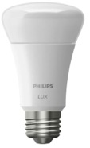
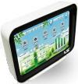
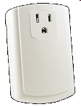
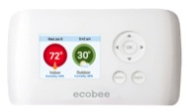
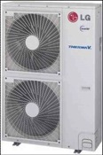
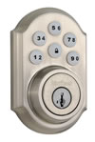
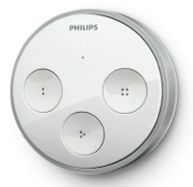
The Power of the Mesh
21

Slide 23
The Power of the Mesh: Self Healing
21

Slide 24
The Power of the Mesh: Self Healing
21

Slide 25
Zigbee Wireless Networking Basics
Network Scan
Device scans the available 16 2.4 GHz channels to determine the best channel to occupy
Creating/Joining a PAN
Device can create a network (coordinator) on a free channel or join an existing network
Device Discovery
Device queries the network to discover the identity of devices
Service Discovery
Device scans for supported services on devices within the network
Binding
Devices communicate via command/control messaging
25

Slide 26
Zigbee Stack Architecture Basics
Addressing
Every device has a unique 64 bit MAC address
Upon association, every device receives a unique 16 bit network address
Only the 16 bit network address is used to route packets within the network
Devices retain their 16 bit address if they disconnect from the network. However, if they LEAVE the network, the 16 bit address is re-assigned.
NWK broadcast implemented above the MAC
26

Slide 27
Zigbee Stack Architecture Basics
Devices
Pre-programmed for their network function
Coordinator
Scans to find an unused channel to start a network
Router (mesh device within a network)
Scans to find an active network to join, then permits other devices to join
End Device
Always tries to join an existing network
Discover other devices in the network providing complementary services
Service Discovery can be initiated from any device within the network
Can be bound to other devices offering complementary services
Binding provides a command and control feature for specially identified sets of devices
27

Slide 28
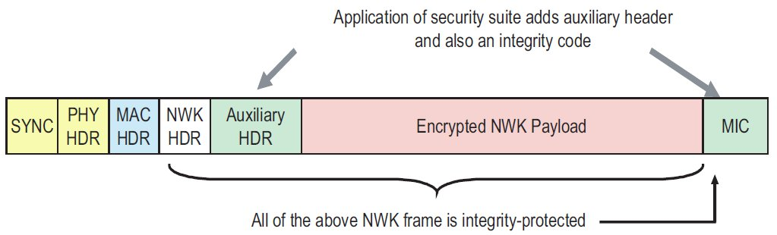
Zigbee PRO Communications Model
Standard Frame Format builds on the 802.15.4 format to add network and application specific commands/responses as part of the 802.15.4 payload
Secure (AES-128 encryption) at network level for all nodes
Additional application layer security available with a single key for every node pair
28
Notes:
<編號>

Slide 29

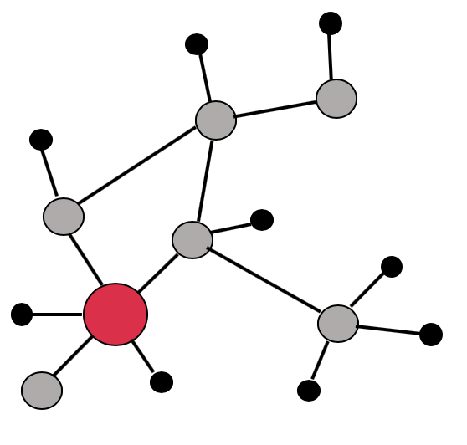


Security & Safety
HVAC
Lighting
Retail
Sensing
Commissioning
Energy metering Appliances
Telecommunication
Flexible self-organizing mesh
Ultra low-power
Library of applications
+
+
Notes:
<編號>

Slide 30
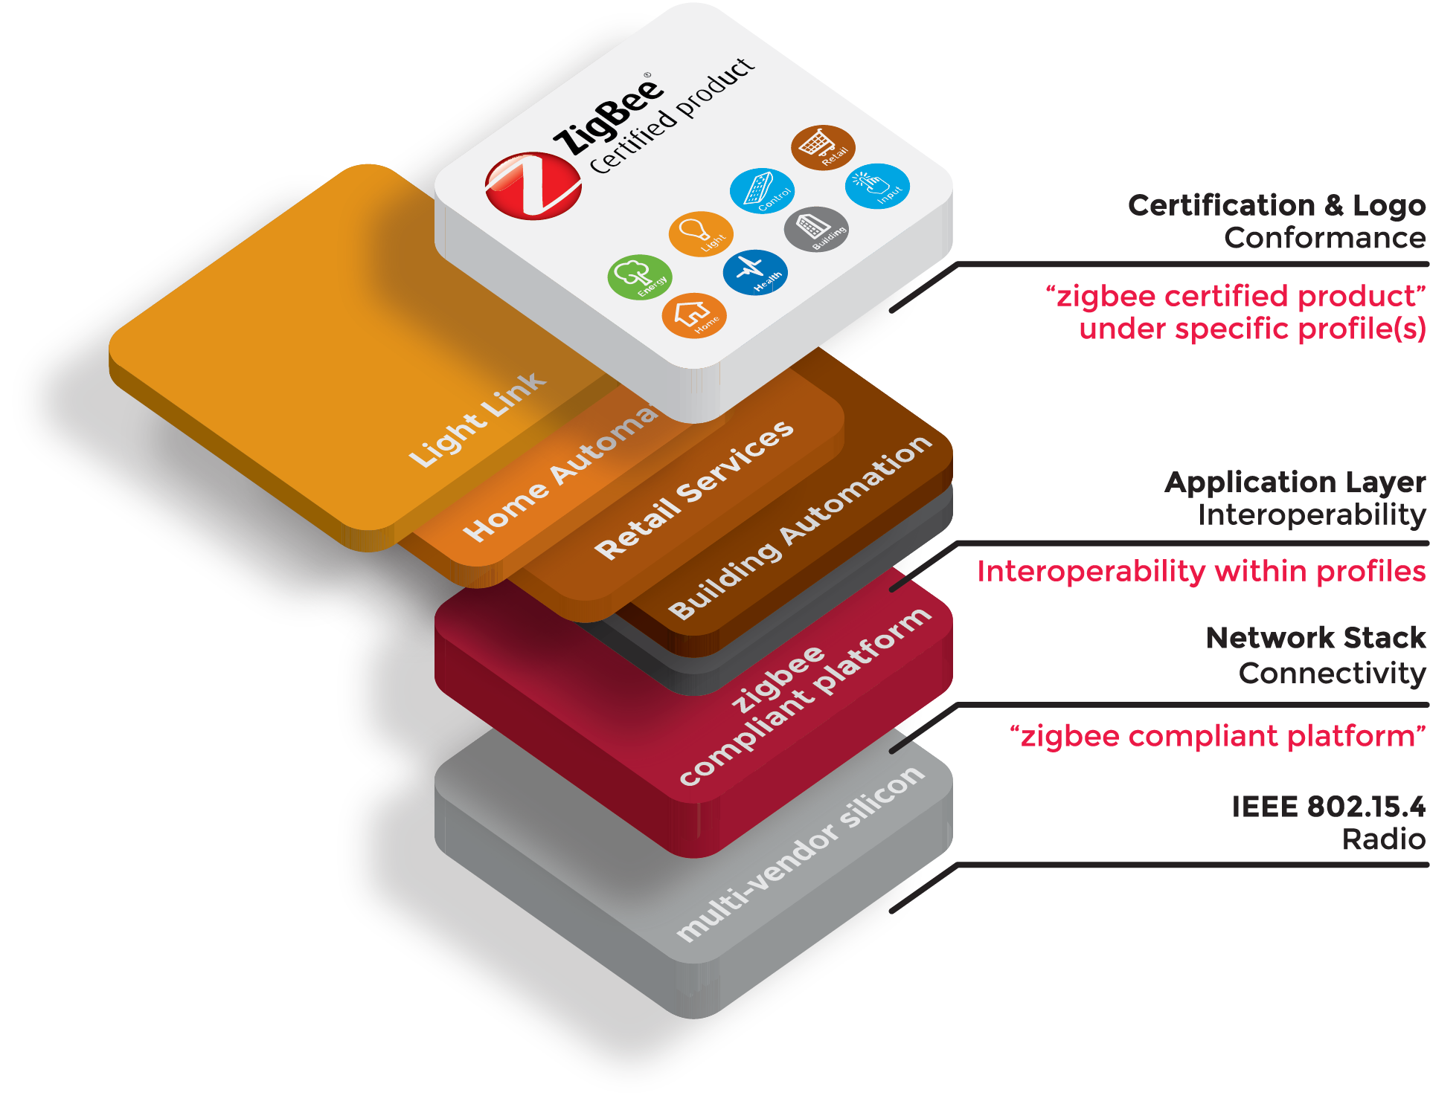




Incorporation of legacy profiles
One device = one specification
Backward-compatible

Slide 31
Zigbee Base Device Behavior: Uniform mandatory commissioning method
Covers the aspects of:
Network formation
Network joining (steering)
Network security
Establishment of application layer control relationships (finding & binding)
Aligned operation

Slide 32

Zigbee Base Device Behavior: Supported network security models
Centralized security network
Distributed security network
Zigbee Coordinator/ Trust Center
Zigbee Router
Zigbee End Device
Only Zigbee Coordinators/Trust Centers can start centralized networks
Nodes join & receive the network key and establish a unique Trust Center link key
Nodes must support install codes
No central node/Trust Center
Routers are able to start distributed networks
Nodes join and receive the network key
Nodes adapt to the model of the network to which they join

Slide 33
Zigbee Base Device Behavior: Joining a Zigbee network
User interaction
User interaction
Receive NWK key
Associate
OPEN
Receive unique TCLK
OPEN
Node not on a network
Perform a channel scan
Select an open network & associate
Receive the network key
If joining a centralized security network, exchange TCLK
Node on a network
Open the network for 180s
Participate in the association as parent
Participate in the key exchange as parent and/or coordinator
Close the network

Slide 34
Zigbee Base Device Behavior: Finding & binding: Control relationships
From Simple Descriptor
Target interaction
Initiator interaction
Target Clusters
Initiator Clusters
Get Simple Descriptor
1
1
2
3
Identify Query Request
3
Identify Query Response
Initiator
Target
Simple Descriptor
Binding Table
Initiator endpoint
Broadcast identify query request & receive responses
Request simple descriptor for an endpoint on the target
Match initiator and target clusters
Target endpoint
Identify for 180s
Respond to requests from the initiator
© ZigBee Alliance. All rights reserved. CONFIDENTIAL

Slide 35
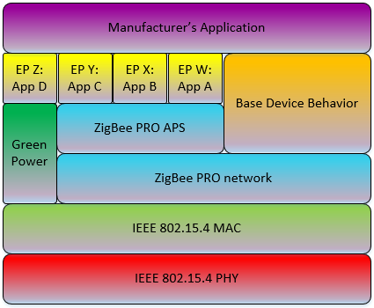
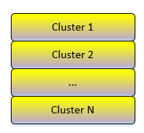
Zigbee: aligning the application
Bringing together device definitions from various profiles
Aligning the DeviceIDs
Aligning the device definitions and requirements
Uniform cluster usage

Slide 36
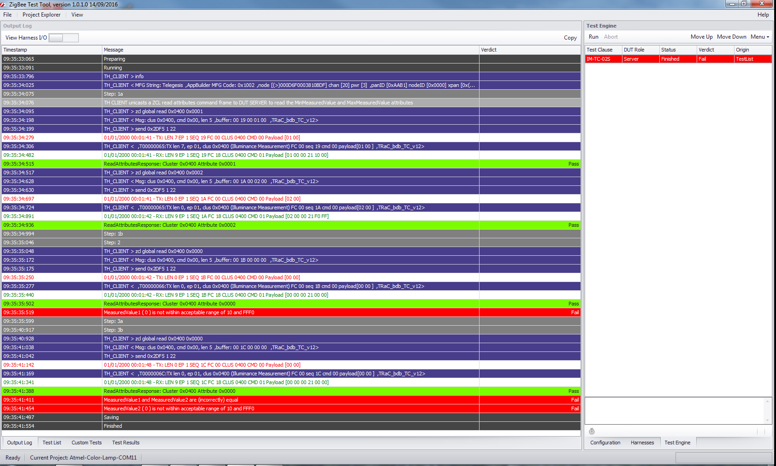
Zigbee: automated testing

Slide 37
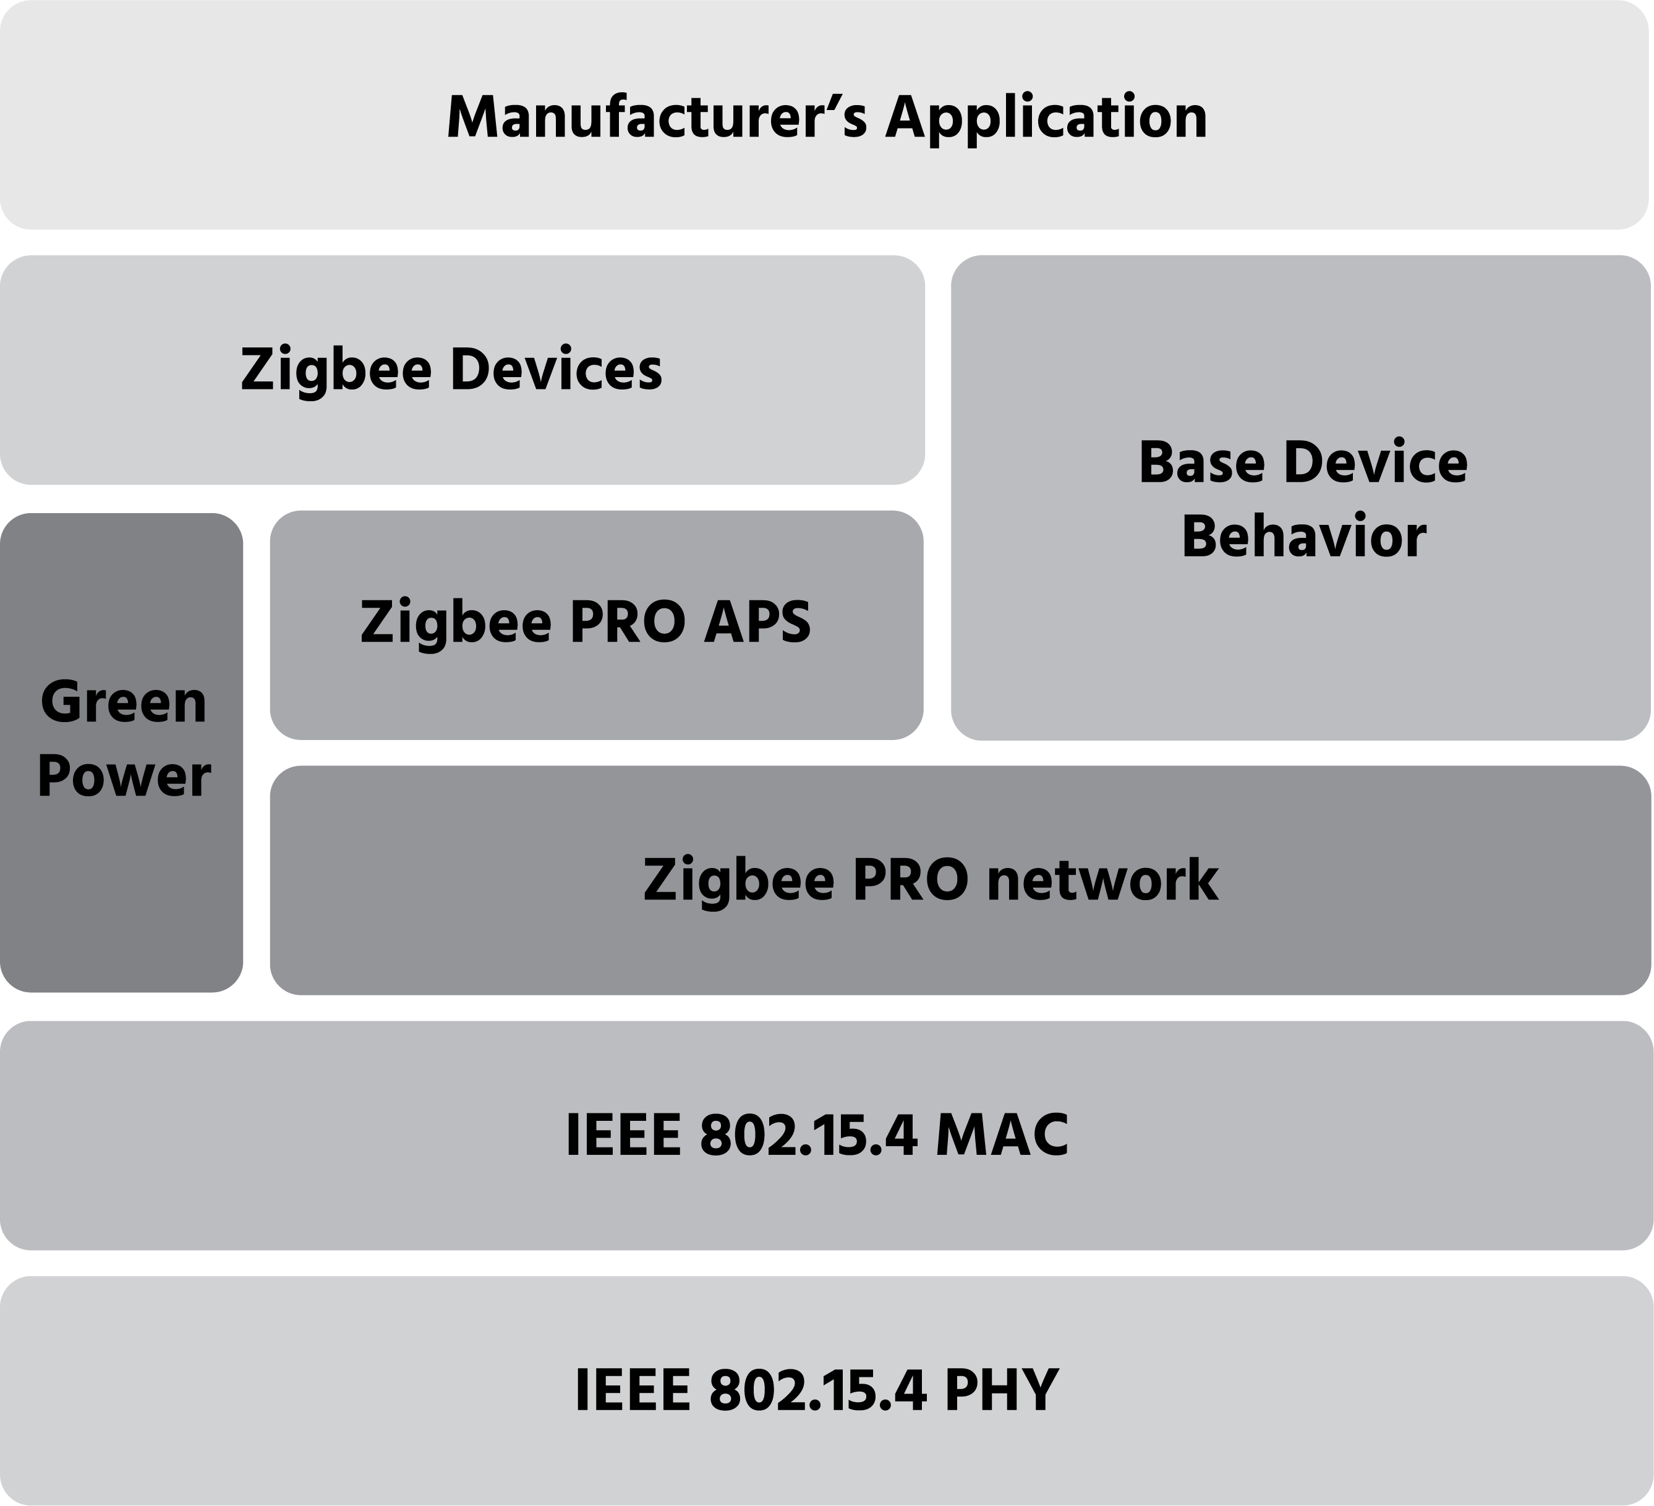
Zigbee Green Power
Proxy functionality mandatory for Zigbee routing devices

Slide 38
Available for automated testing
Device Id | Description
0x0000 | On/Off Switch
0x0001 | Level Control Switch
0x0002 | On/Off Output
0x0003 | Level Controllable Output
0x0004 | Scene Selector
0x0005 | Configuration Tool*
0x0006 | Remote Control*
0x0007 | Combined Interface *
0x0008 | Range Extender
0x0009 | Mains Power Outlet
0x0100 | On/Off Light
0x0101 | Dimmable Light
0x0102 | Color Dimmable Light
0x0103 | On/Off Light Switch
0x0104 | Dimmer Switch
0x0105 | Color Dimmer Switch
Device Id | Description
0x0106 | Light Sensor
0x0107 | Occupancy Sensor
0x010A | On/Off Plug In Unit
0x010B | Dimmable Plug In Unit
0x010C | Color Temperature Light
0x010D | Extended Color Light
0x0201 | Shade Controller
0x0202 | Window Covering Device
0x0203 | Window Covering Controller
0x0302 | Temperature Sensor
0x0800 | Color Controller
0x0810 | Color Scene Controller
0x0820 | Non-Color Controller
0x0830 | Non-Color Scene Controller
0x0840 | Control Bridge
0x0850 | On/Off Sensor
* Limited to implemented Clusters being already supported in Zigbee Test Tool

Slide 39
Evolution of our Application Layer

Slide 40
Evolution of our Application Layer
Interoperable app layer
The Alliance developed the first open, interoperable, certified application layer for multiple key verticals
Major successes in smart energy, smart home, & lighting
Lessons
As IoT evolved, interoperability between verticals became increasingly important

Slide 41
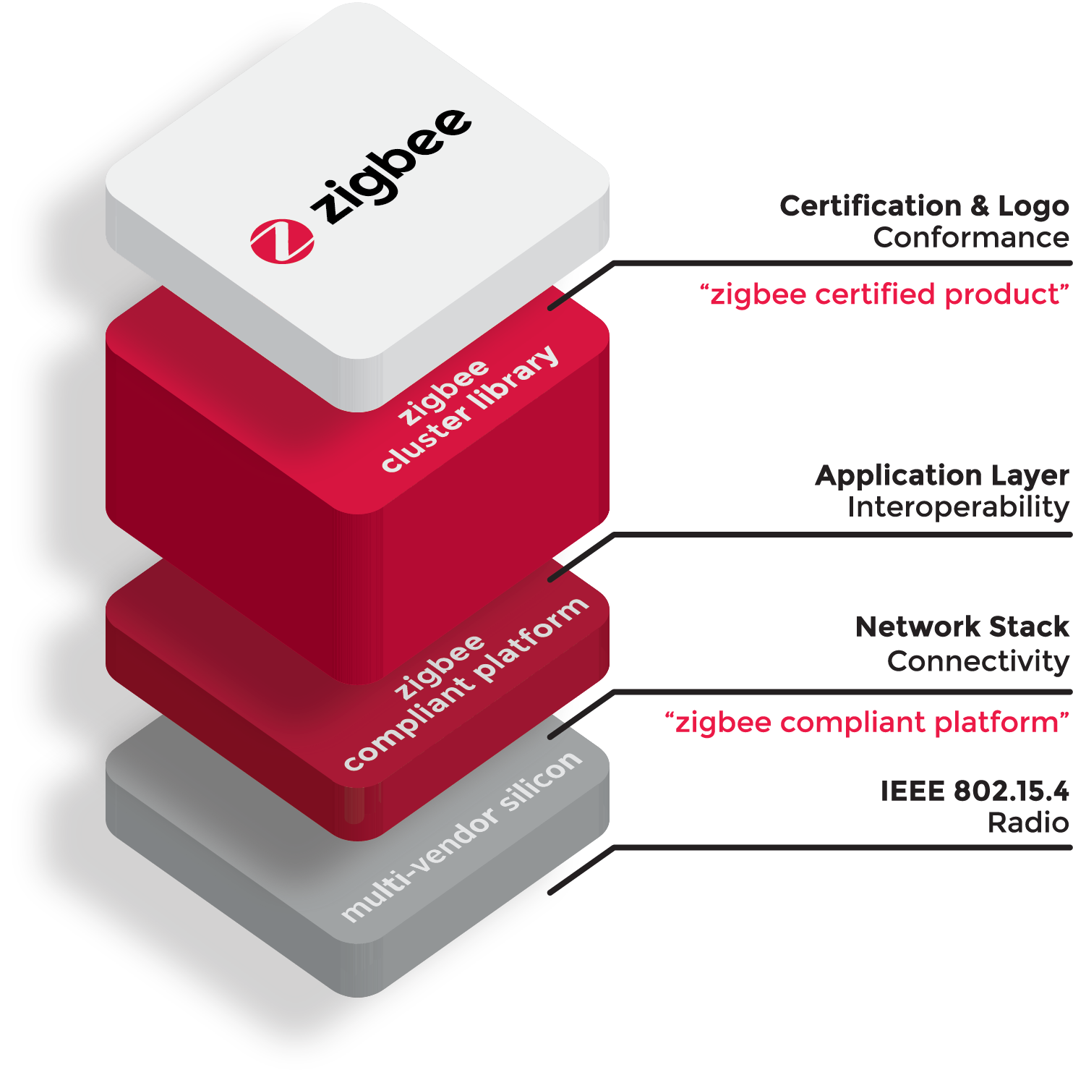
Evolution of our Application Layer
Consolidated App Layer
With Zigbee, we’ve brought all our profiles under one technology
Evolution of the most mature, widely-deployed, well-supported application layer
Lessons
IoT needs a universal language, and Zigbee’s Cluster Library is the most robust
High demand to expand this across other networks.

Slide 42

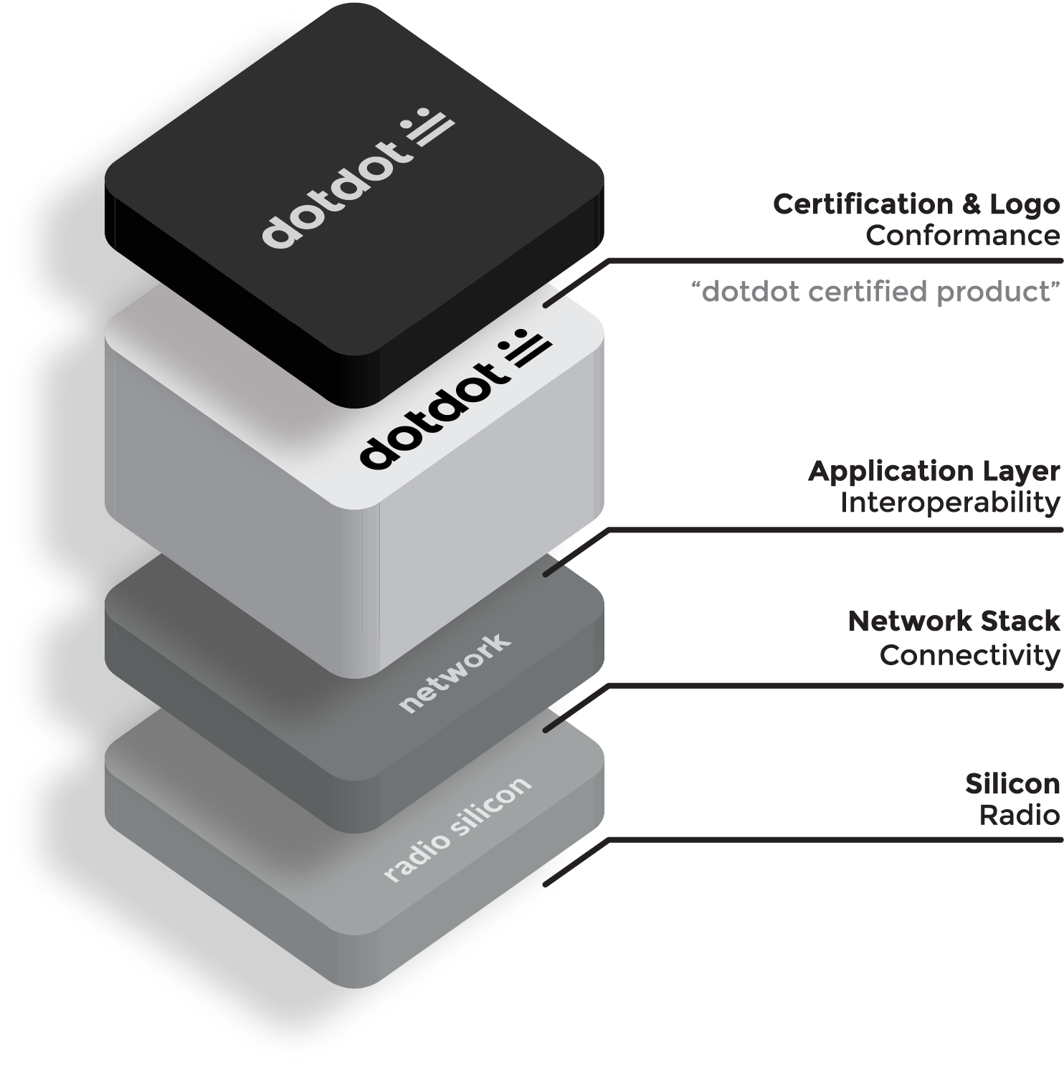
Evolution of our Application Layer
Meet
The new name for our application layer (formerly ZCL), that can be built across Zigbee, IP, and other transports
Comes to market with maturity, and an ecosystem of suppliers, manufacturers, and experts
Product vendors’ investment in Zigbee & Dotdot will scale across multiple markets and applications.
Notes:
<編號>

Slide 43
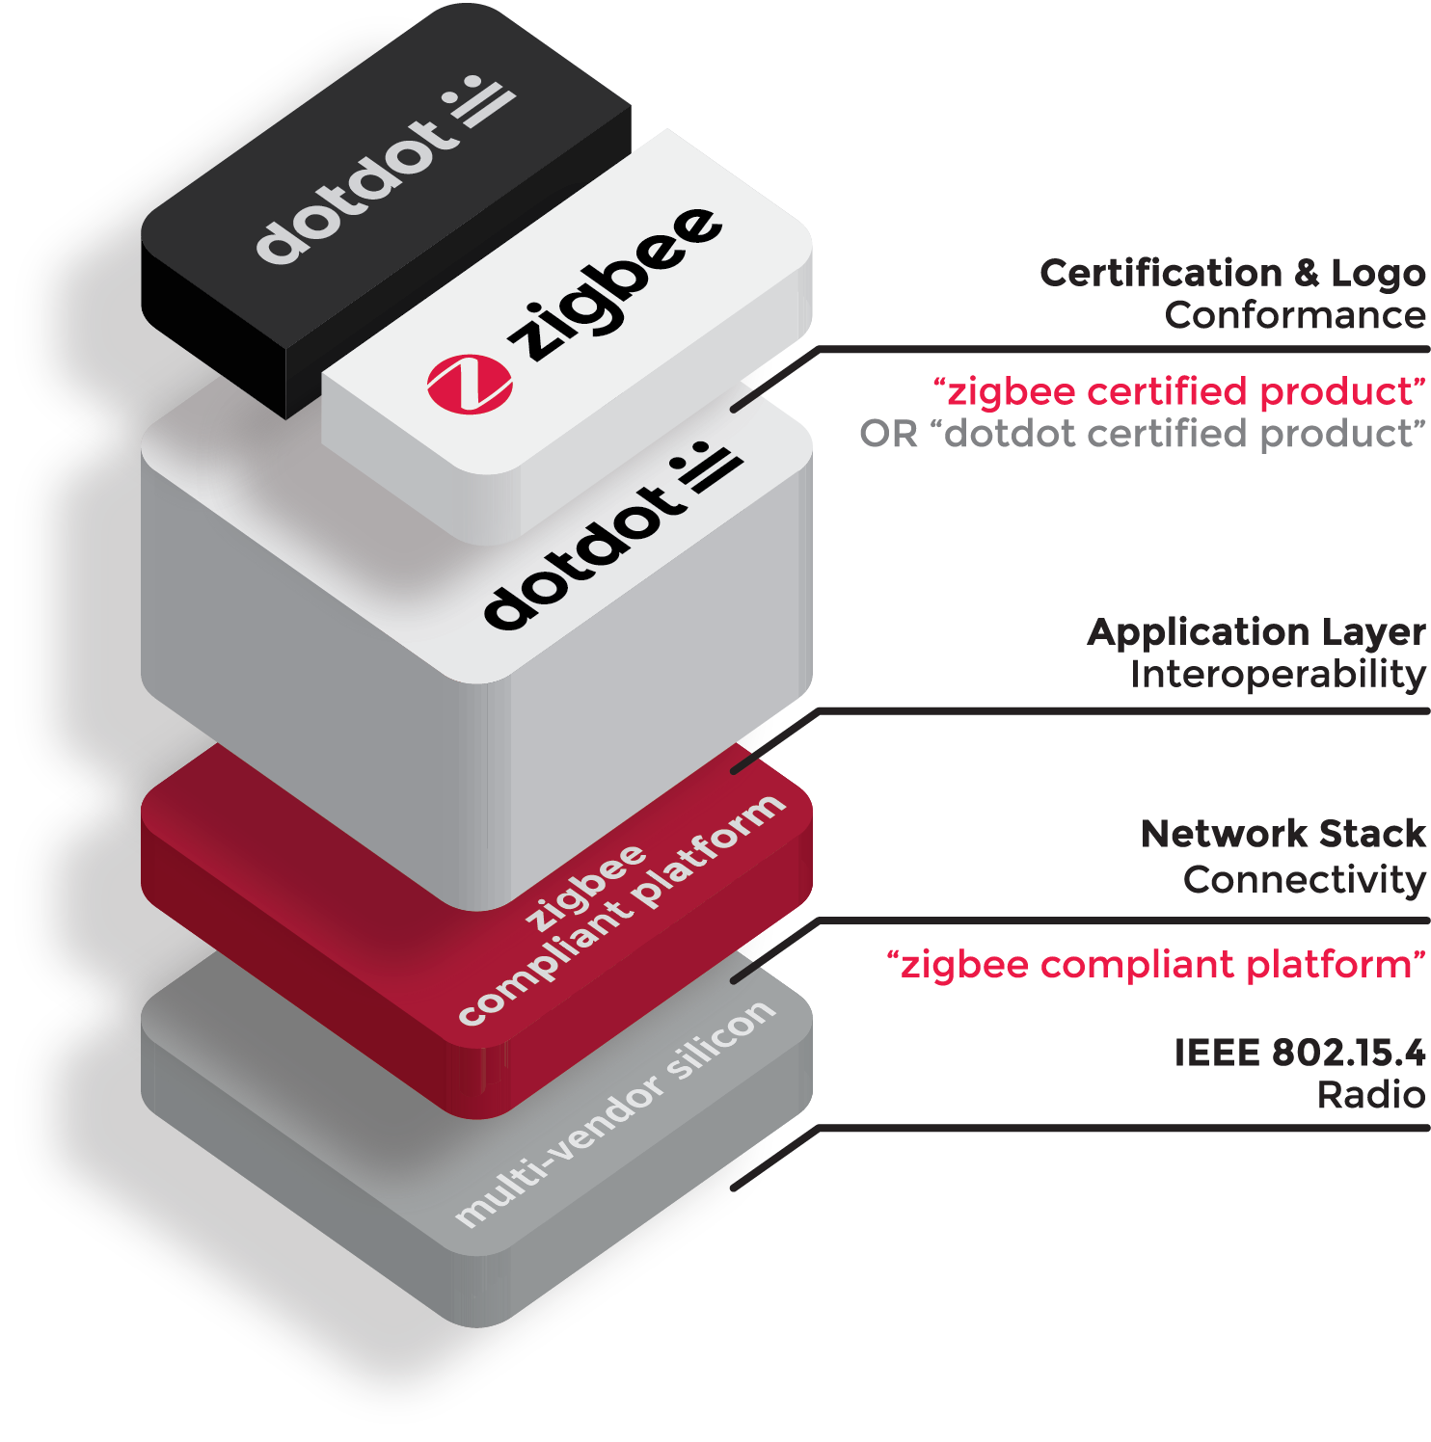
Dotdot and Zigbee
Zigbee devices today already use Dotdot
We will be launching a certification and logo program for Dotdot in 2018
Products will be able to certify & label as both, for continuity and to indicate connectivity.
© 2017 zigbee alliance. All rights reserved.
Notes:
<編號>

Slide 44
Green Power

Slide 45
What is Green Power?
Green Power is a feature of Zigbee PRO networks
Integrating battery-less (energy harvesting-based) or life-long battery operated devices into the Zigbee network
Key benefit: adds nodes/devices to the network that are virtually completely maintenance free
Green Power adds green capability to Zigbee by eliminating battery usage and waste
Notes:
<編號>

Slide 46
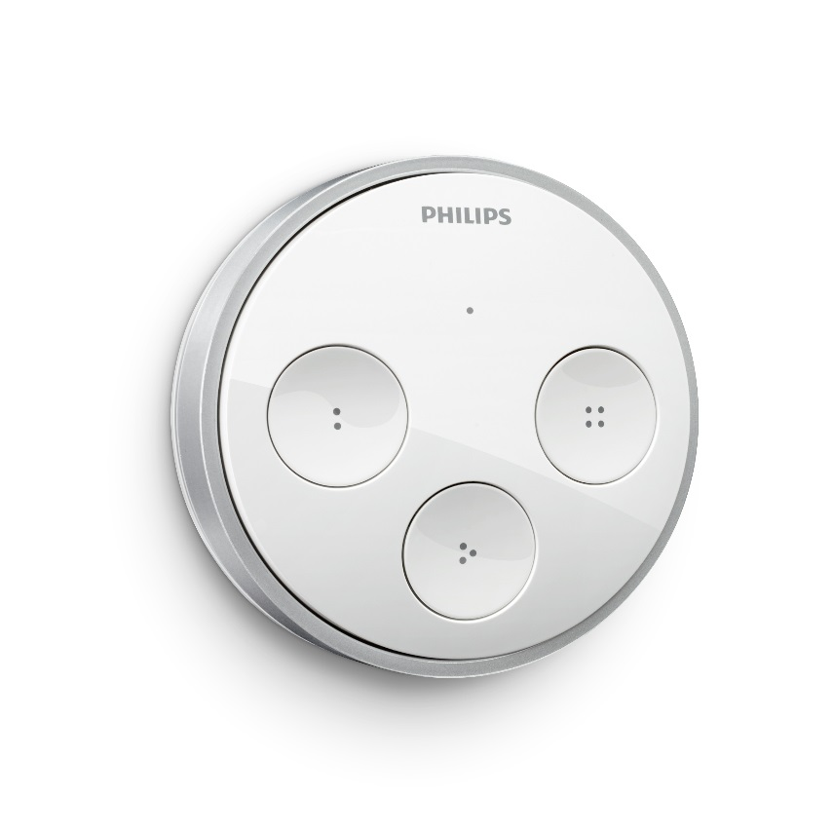
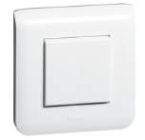
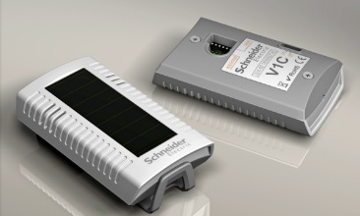
Green Power applications
(Light) switch: flipping the switch generates the energy for data-communication
Sensors, open/close detectors, emergency buttons, industrial switches, …

Slide 47

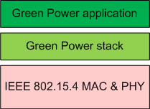
Green Power Device (GPD)
Green Power Device Frame
GPD
Compact frame with:
unique identification of the Green Power Device (GPD)
Scalable security
Future-proof application framework
GPD is *NOT* a ZED! It’s less.

Slide 48
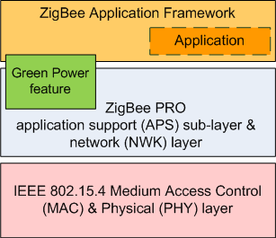
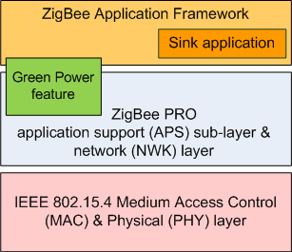
Green Power & Zigbee PRO: Proxy & Sink
Green Power Device Frame
ZCL frame carrying Green Power information
Proxy
GPD
Sink
Application-agnostic

Slide 49
Green Power: Proxy functionality
Green Power Device Frame
Zigbee frame carrying Green Power information
Proxy 1
GPD
Sink
Proxy 2
Proxy forwarding:
to paired sinks (unicast or group)
reliably: using multiple proxies in range of the GPD (no single parent problem)
efficiently (bandwidth usage)
Proxy 3

Slide 50
Green Power: Commissioning
Green Power Device Frame
Zigbee frame carrying Green Power information
Proxy
GPD
Sink
Commissioning:
brings the Green Power Device on the operational channel;
bootstraps GPD security;
creates a control relationship between the Green Power Device and the sink – at the sink;
Without tools; in the same simple user interaction

Slide 51
Green Power: Management
Green Power Device Frame
Zigbee frame carrying Green Power information
Proxy 1
GPD
Sink
Zigbee
Control and optimization of Green Power operation
Proxy 2
Proxy 3

Slide 52
Zigbee Green Power where mains and battery are impractical or for lifelong battery life
Zigbee Coordinator & Trust Center
A router dedicated to managing security credentials and performing other network management tasks in a centralized manner
Zigbee Router
Mains powered, always on
Zigbee End Device
Battery powered, fully bi-directional
Zigbee Green Power Device
Energy-harvesting (battery-less) or life-long battery; may be transmit-only;
E.g. switches, setpoint controllers, sensors
Energy & complexity
Notes:
<編號>

Slide 53
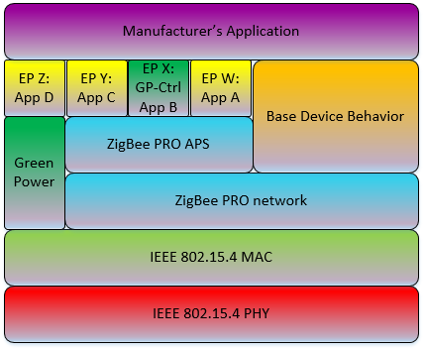
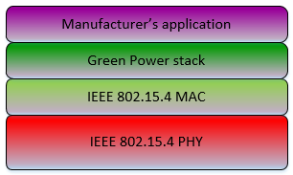
Zigbee Green Power explained
Green Power Device Frame
Zigbee frame carrying Green Power information
Green Power Device
Proxy
Sink
Application-agnostic
© Zigbee Alliance. All rights reserved. CONFIDENTIAL

Slide 54
Green Power in Zigbee 3.0
<編號>

Slide 55
Security Considerations
Notes:
<編號>

Slide 56
Standardized at all Layers
Encryption Support
AES 128 Security with varying keys

Slide 57
Zigbee PRO Communications Model
Standard Frame Format builds on the 802.15.4 format to add network and application specific commands/responses as part of the 802.15.4 payload
Secure (AES-128 encryption) at network level for all nodes
Additional application layer security available with a single key for every node pair
<編號>
Notes:
<編號>

Slide 58
Location Awareness

Slide 59
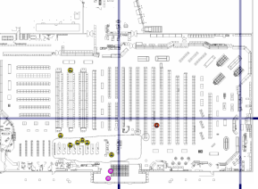
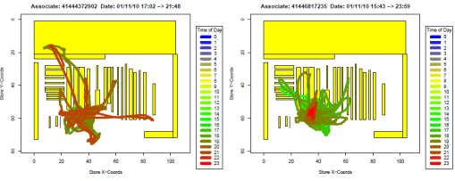
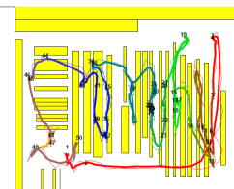
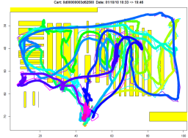
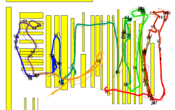
Zigbee Service Information
Real-time Information
Associate Tracking
Trolley Tracking
Customer Tracking
Notes:
<編號>

Slide 60
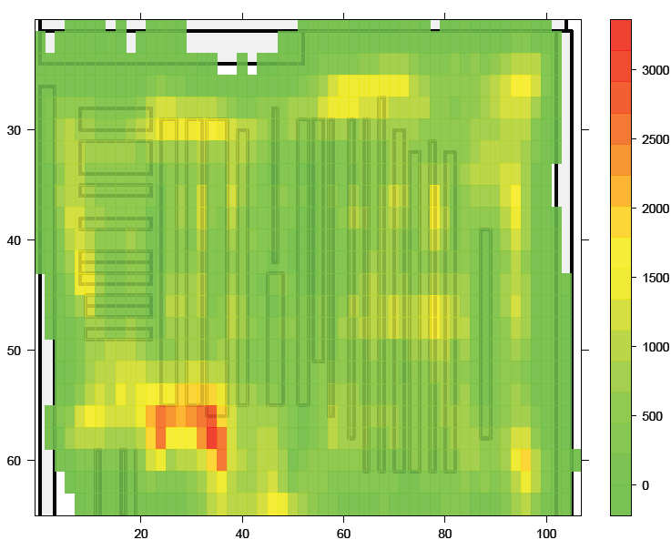
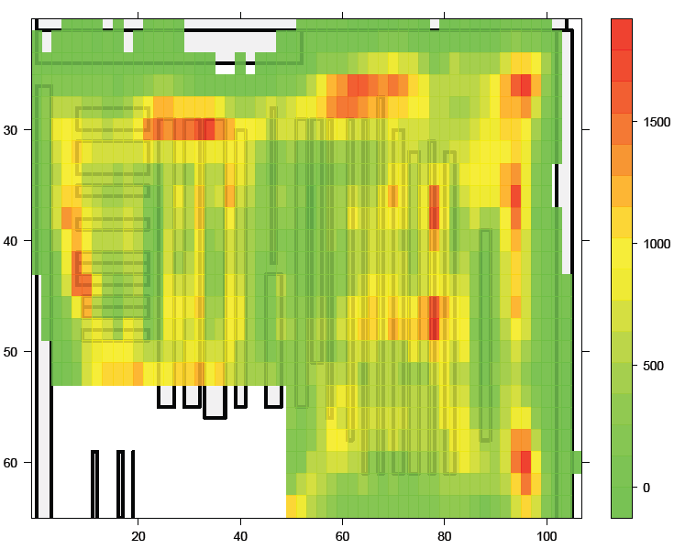
Store Heat Maps
Checkout Area

Slide 61
Wireless Coexistence
<編號>

Slide 62
The Challenge
Co-existence in a crowded spectrum is a major concern for any wireless network
There is a multitude of products in use today that operate in the 2.4 GHz ISM band
Bluetooth
Wi-Fi
Microwave ovens
Etc.
IEEE 802.15.4 standard (and protocols based on it) is equipped with system attributes that are key to surviving the interference rich 2.4 GHz environment

Slide 63
IEEE 802.15.4 Pedigree
Global standard
Variety of sources
Technology in mass production since 2003
Optimized for low duty cycle application
Longer battery life (months to years)
Small packets (short Tx times)
Interference avoidance
DSSS
CSMA-CA
Short burst transmission
Retries

Slide 64
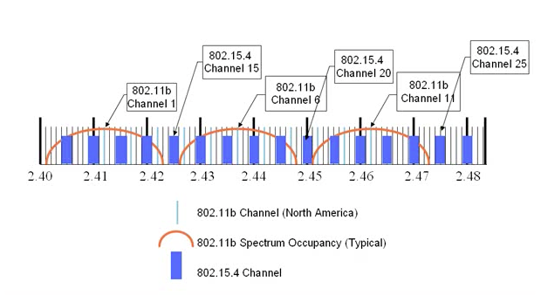
IEEE 802.15.4 Spectrum Usage

Slide 65
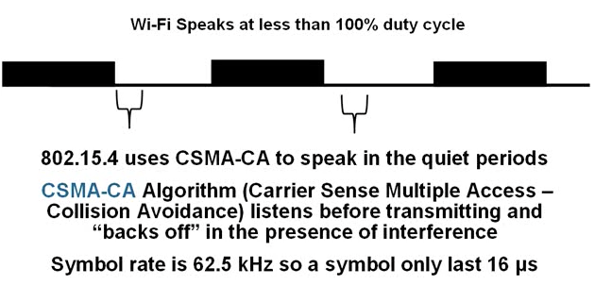
IEEE 802.15.4 CSMA-CA

Slide 66
Network Level Enhancements
Networking Protocols can extend the interference avoidance capabilities of IEEE 802.15.4 by providing advanced protocol features to deal with interference sources
Zigbee PRO
Network level acknowledgements
Network Level re-tries
Frequency Agility
Network Moves to “cleaner” spectrum
Zigbee RF4CE
Multi-channel operation
IEEE 802.15.4 channels 15, 20, and 25

Slide 67
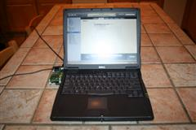
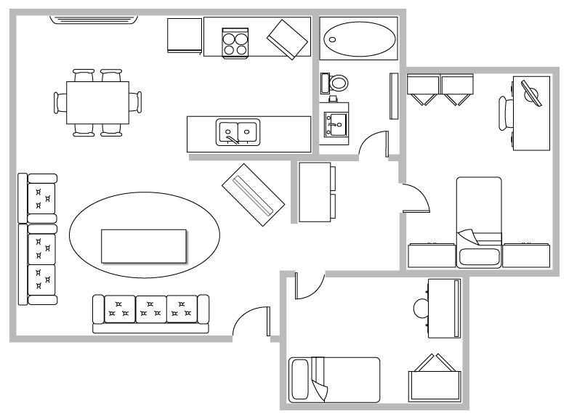
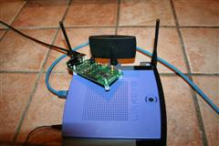
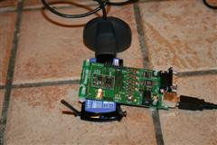
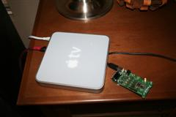
Testing the Theory
Meda Content
(placed on top of wi-fi antenna)
Wi-Fi (a/b/g/n) access point
25 feet
TV – AppleTV
(placed on top of AppleTV)

Slide 68

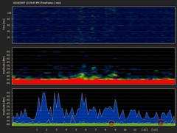
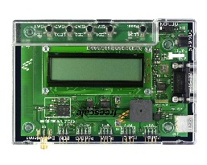
No Interference
PER testing: 1000 packets with 40/90 Bytes of payload
PER testing: output power set to min/nominal/max
Packet success rate and average TX time recorded
Notes:
<編號>

Slide 69
No Interference Results
PER testing: 1000 packets with 40/90 Bytes of payload
PER testing: output power set to min/nominal/max
Packet success rate and average TX time recorded
Notes:
<編號>

Slide 70
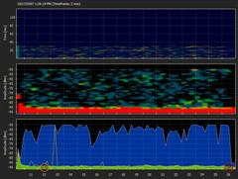
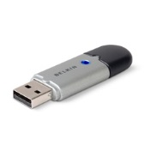
Bluetooth Interference
PCs doing Bluetooth file Transfer
PER testing: 1000 packets with 40/90 Bytes of payload
PER testing: output power set to min/nominal/max
Packet success rate and average TX time recorded
Notes:
<編號>

Slide 71
Bluetooth Interference Results
PCs doing Bluetooth file Transfer
PER testing: 1000 packets with 40/90 Bytes of payload
PER testing: output power set to min/nominal/max
Packet success rate and average TX time recorded
Notes:
<編號>

Slide 72




Wi-Fi N & AppleTV Interference Setup
Wi-Fi tested on N mode
Tests performed while uploading 1.42 GB data
via Wi-Fi to Apple TV from laptop
802.15.4 hardware antenna placed directly on
external PCMCIA Wi-Fi card in laptop
PER testing: 1000 packets with 40 Bytes of payload
PER testing: output power set to min/nominal/max
Packet success rate and average TX time recorded
Notes:
<編號>

Slide 73

Wi-Fi N & AppleTV Interference Results
Notes:
<編號>

Slide 74
Zigbee: A toolbox

Slide 75
Zigbee 3.0: flexibility of Zigbee PRO A toolbox for many needs
Security:
Centralized? Distributed?
Routing:
Table routing? Many to one routing? Source routing?
Addressing:
Unicast? Groupcast? Broadcast?
© Zigbee Alliance. All rights reserved. CONFIDENTIAL

Slide 76










Applications
© Zigbee Alliance. All rights reserved. CONFIDENTIAL

Slide 77




Applications
Hampshire City Council, Hampshire UK: 90,000 connected street lights
GM Spring Hill Plant: 28,773 connected lights, 20 million square feet
Aria Hotel City Center, Las Vegas:
+ 100,000 Zigbee devices

Slide 78
Summary

Slide 79
Security & Safety
HVAC
Lighting
Retail
Sensing
Commissioning
Energy metering Appliances
Telecommunication
Flexible self-organizing mesh
Ultra low-power
Library of applications
+
+

Slide 80
Zigbee Base Device Behavior: Joining a Zigbee network
User interaction
User interaction
Receive unique TCLK
Associate
OPEN
Receive NWK key
OPEN
Joining device
Perform a channel scan
Select an open network & associate
Authenticate
Receive the network key
If joining a centralized security network, exchange TCLK
Node on a network
Open the network for 180s
Participate in the association as parent
Participate in the key exchange as parent and/or coordinator
Close the network

Slide 81
The Alliance has made building Zigbee devices easy

Slide 82

Building a Zigbee device

Slide 83

1. Development Zigbee Compliant Platforms
More than 2,500 Zigbee products have been built and certified on our Compliant Platforms.
Includes 250 manufacturers using Zigbee standards for smart home, smart building, and connected city
More than 20 Compliant platforms to choose from that support Zigbee & wide industry support
Silicon from eight major vendors now certified, with many more module, software and integration support members ready to help product developers build Zigbee products

Slide 84
1. Development Technical Specifications
Solution | Description
Network Protocol | Zigbee PRO 2015 (or newer)
Network Topology | Self-forming, Self-healing MESH
Network Device Types | Coordinator (routing capable), Router, End Device
Network Size (# of nodes) | Up to 65,000
Radio Technology | IEEE 802.15.4-2011
Frequency Band / Channels | 2.4 GHz (ISM band) 16-channels (2 MHz wide)
Data Rate | 250 Kbits/sec
Security Models | Centralized (with Install Codes support) Distributed
Encryption Support | AES-128 at Network Layer AES-128 available at Application Layer
Communication Range (Average) | 300+ meters (line of sight) 75-100 meters indoor
Low Power Support | Sleeping End Devices Zigbee Green Power Devices (energy harvesting)
Legacy profile support | Zigbee 3 devices can join legacy Zigbee profile networks. Legacy devices may join Zigbee 3 networks (based on network’s security policy)
Logical device support | Each physical device may support up to 240 end-points (logical devices)

Slide 85

2. Testing The Zigbee Test Harness
The Test Harness is an affordable way to enable product developers to check the functionality of their implementations before starting the official testing process.
This brings a common test platform to all labs, and is available to members

Slide 86





2. Testing Authorized test service providers
Zigbee devices can be tested at any of its five authorized test service providers, at any of their worldwide locations

Slide 87
3. Certification Certification Programs
After testing, the Zigbee Alliance will review submissions.
Approved devices will then be able to display the Zigbee Certified logo, and join the global ecosystem of half a billion Zigbee devices with confidence that the device will be interoperable.

Slide 88
Thank you.
For more information, please contact help@zigbee.org

